Slide 1
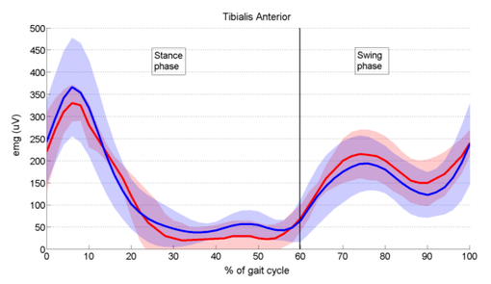
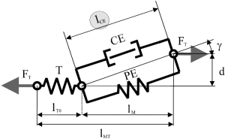
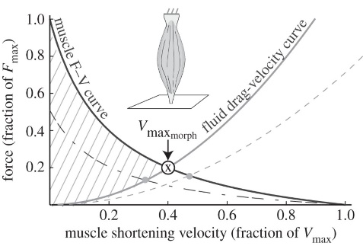
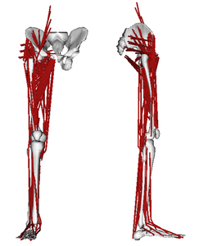
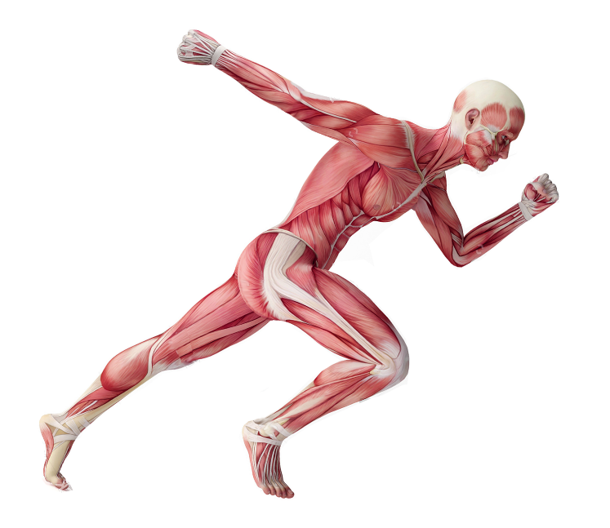
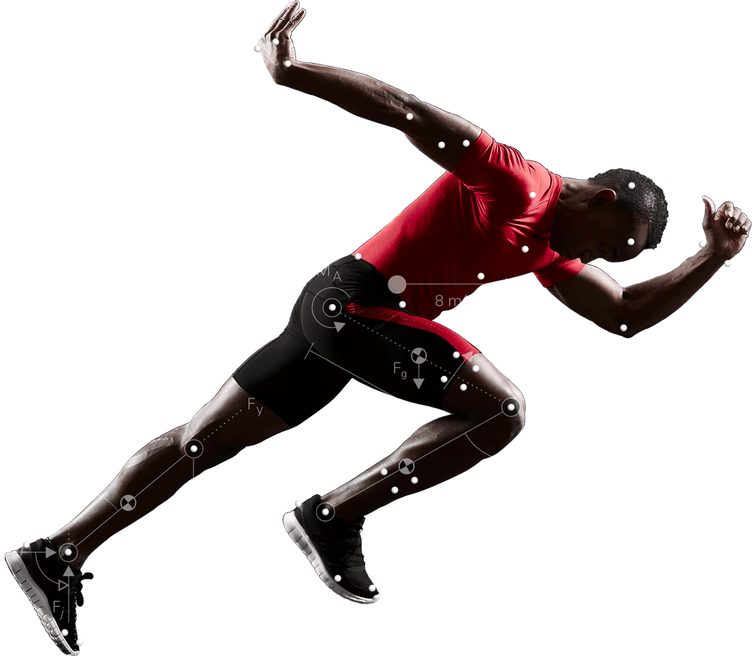
EMG Based Motion Capture [Seminar] From Motion Capture to Musculoskeletal Simulation and back
M
θ
M
θ
M
θ
F
F
Felix Laufer

Slide 2
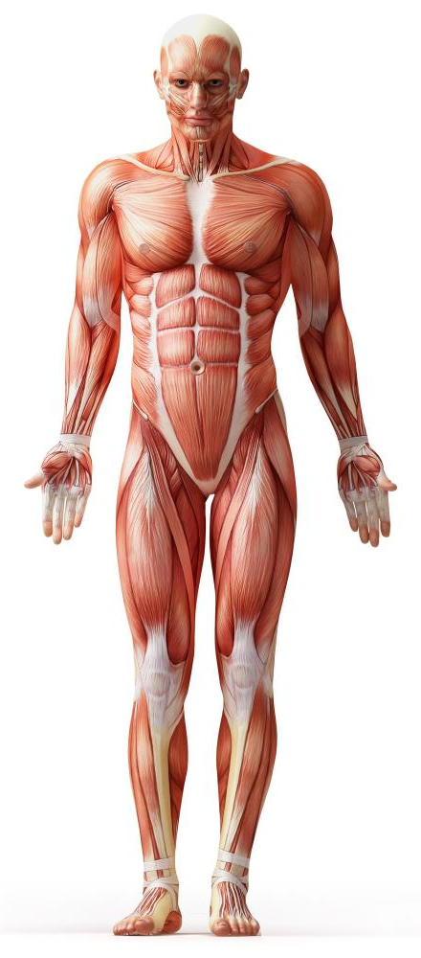
Why Musculoskeletal Simulation?
Human Computer Interaction
HCI
Medicine
Design ergonomically safe environments
Industrial Ergonomics
Sports
Investigate and treat movement disorders
Build wearable assistive devices (orthoses and prostheses)
Biomechanical Basic Research
Analyze and improve athletic performance
Understand the human
locomotion system in detail

Slide 3
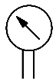

From MoCap to Musculoskeletal Simulation
θ
M
θ
M
θ
M
F
F
Motion Capture
Inverse Kinematics
Inverse Dynamics
Musculoskeletal Simulation
forces, torques
?
marker trajectories
joint angles
muscle activation and forces
marker
points
skeletal model,
kinematic chain
external
forces, GRF, …
body model,
mass distribution,
inertia matrix, …

Slide 4
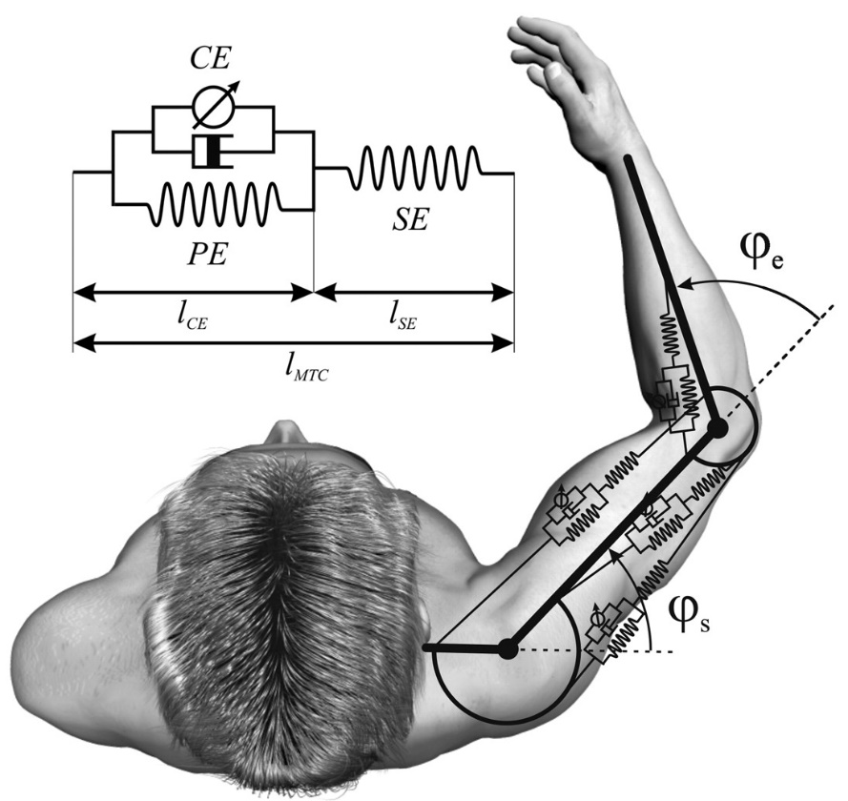
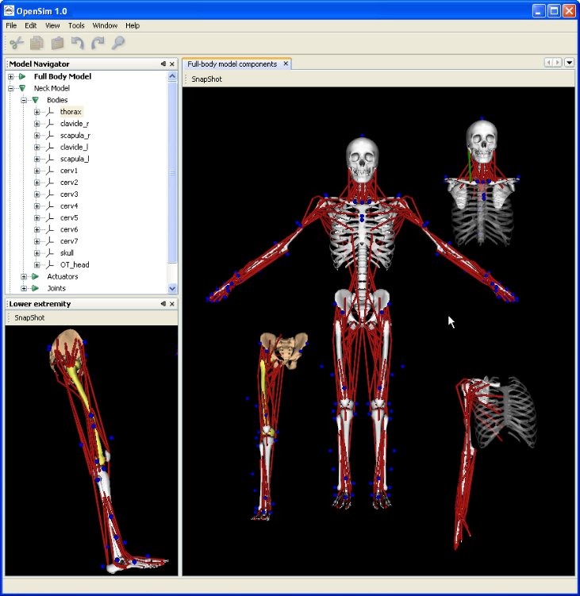
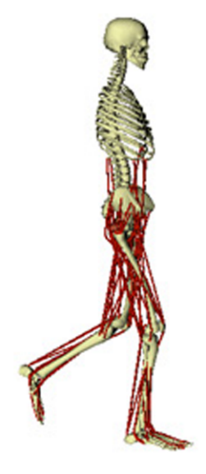
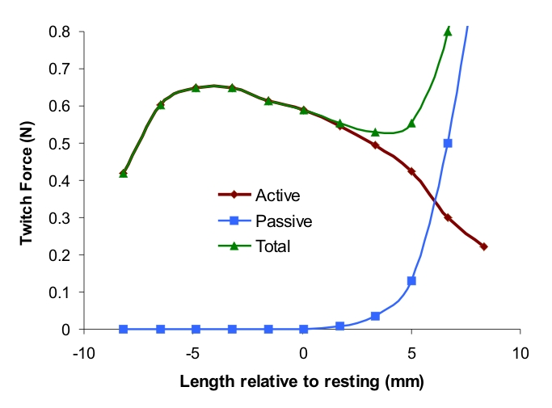

Musculoskeletal Modelling
$$≔$$
Hill‘s muscle model
Musculo Tendon Unit (MTU)
abstract model of motor neurons including all innervated muscle fibers and the tendon of a commonly controlled skeletal muscle based on hill‘s model
Musculoskeletal Models

Slide 5
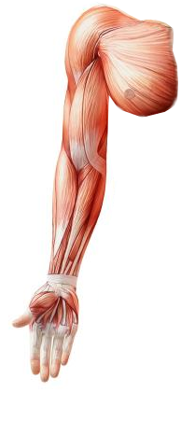

Muscular Redundancy and the DOF Problem
shoulder pitch
shoulder roll
shoulder yaw
elbow pitch
elbow roll
wrist yaw
wrist pitch
segment forces, torques
muscle activation and forces
complex mapping!
Arm excluding hand:
7 kinematic DOF but > 20 skeletal muscles
joints are over-actuated ⬄ muscle system is underconstrained
multiple solutions of the inverse muscle Jacobian

Slide 6

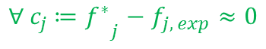
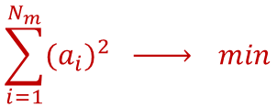

The (classical) Optimization Approach
Idea: Pick the solution that minimizes total muscle stress!
Treat the desired / measured dynamics${ f}_{j}$ as constraints
and the sum of generating muscle forces / activation $a_{i}$of $N_{m}$
muscles as a global performance criterion to be minimized
$$\sum_{i=1}^{N_{m}}{{{(a}_{i})}^{2} \underset{→}{ } min}$$
s.t.
$${{{∀ c}_{j} ≔f}^{∗}}_{j}−f_{j, exp}≈0$$
Always an appropriate method for estimating muscle forces / activation?
What about …
co-contraction
fine motor tasks with higher muscle tension
extreme (fast) movements
(temporal / pathological) muscle fatigue … ?
neurophysiological redundancy
several MTU recruitment
strategies for different motor tasks

Slide 7
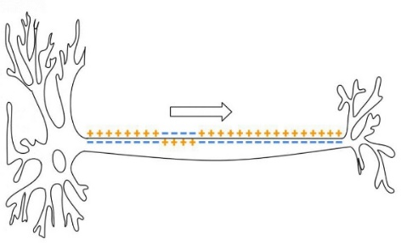
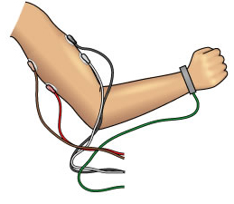
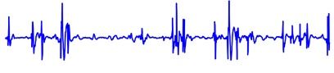
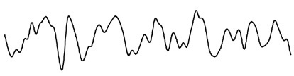

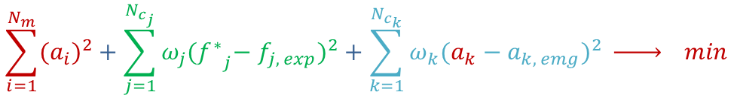
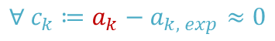

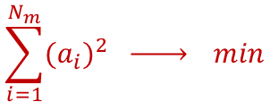
EMG Data for Estimating Muscle Activation
$$≔$$
Electromyography (EMG)
Electrodiagnostic technique for detecting accumulated action potentials
of a skeletal muscle (group) generated by the associated motor neurons
Signal Processing
Idea: Use EMG data for estimating the wanted muscle activation!
Treat the EMG data${ a}_{k,emg}$ corresponding to the wanted muscle activation $a_{k}$
as additional contraints
$$\sum_{i=1}^{N_{m}}{{{(a}_{i})}^{2}}+\sum_{j=1}^{N_{c_{j}}}{ω_{j}{{{(f}^{∗}}_{j}−f_{j, exp})}^{2}+\sum_{k=1}^{N_{c_{k}}}{ω_{k}{(a_{k}−a_{k, emg})}^{2} }}\underset{→}{ } min$$
$$\sum_{i=1}^{N_{m}}{{{(a}_{i})}^{2} \underset{→}{ } min}$$
s.t.
solvability!
$${{{∀ c}_{j} ≔f}^{∗}}_{j}−f_{j, exp}≈0$$
$${{∀ c}_{k} ≔a}_{k}−a_{k, exp}≈0$$

Slide 8
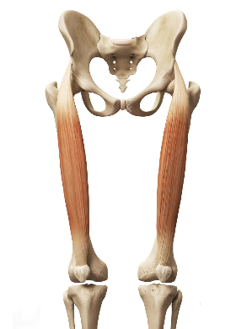
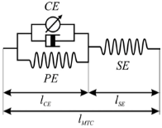

The other Way round – EMG Forward Simulation
Motion Simulation
Motion Capture
Inverse Kinematics
Forward Kinematics
Inverse Dynamics
Forward Dynamics
Musculoskeletal Simulation
Musculoskeletal Modelling
marker trajectories
joint angles
forces, torques
muscle activation and forces
Idea: Use EMG data to directly drive a model‘s forward dynamics!
$$≔$$
Common Approach: Single DOF Model
Model predicting the joint moment at one single calibrated DOF from EMG data recorded at the associated MTU
hip roll (AA)
MTU
hip pitch (FE)
rectus
femoris
knee pitch (FE)
rectus femoris EMG data
Again, the redundancy / DOF problem!
Single DOF models can address neurophysiological redundancy for a certain DOF but not muscular redundancy in terms of multiple DOF.
Single DOF models produce valid solutions for each DOF separately
but inconsistent solutions amongst multiple DOF

Slide 9
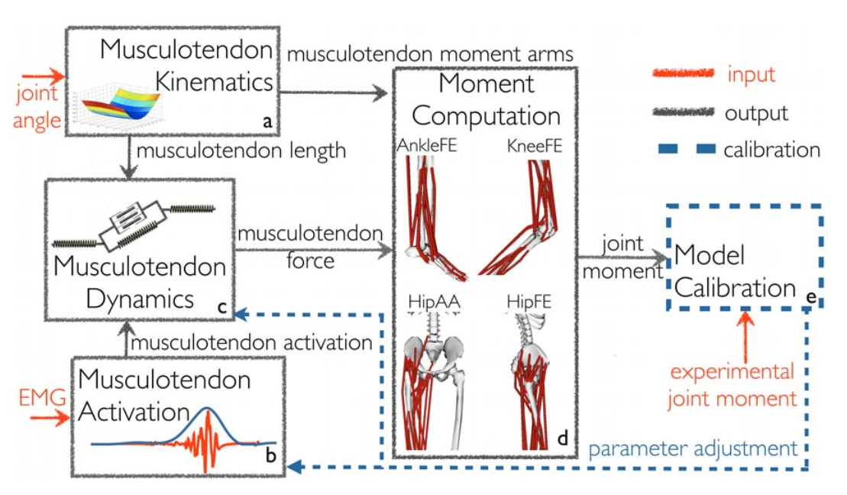
EMG Forward Simulation – Multi DOF Model
Idea: Build a Multi DOF Model calibrated for several DOF ➔ consistent force solution!
optimization

Slide 10
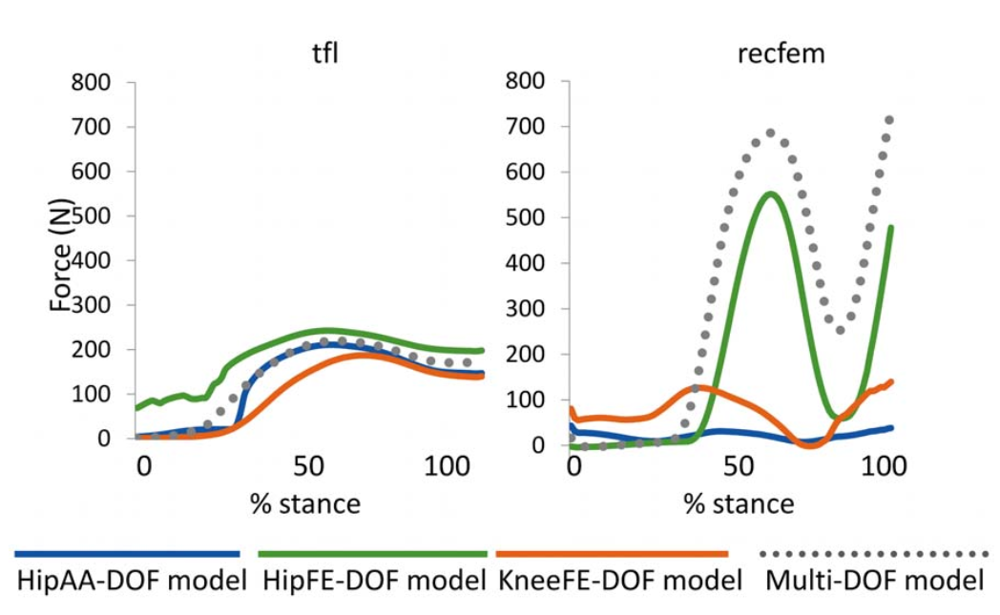
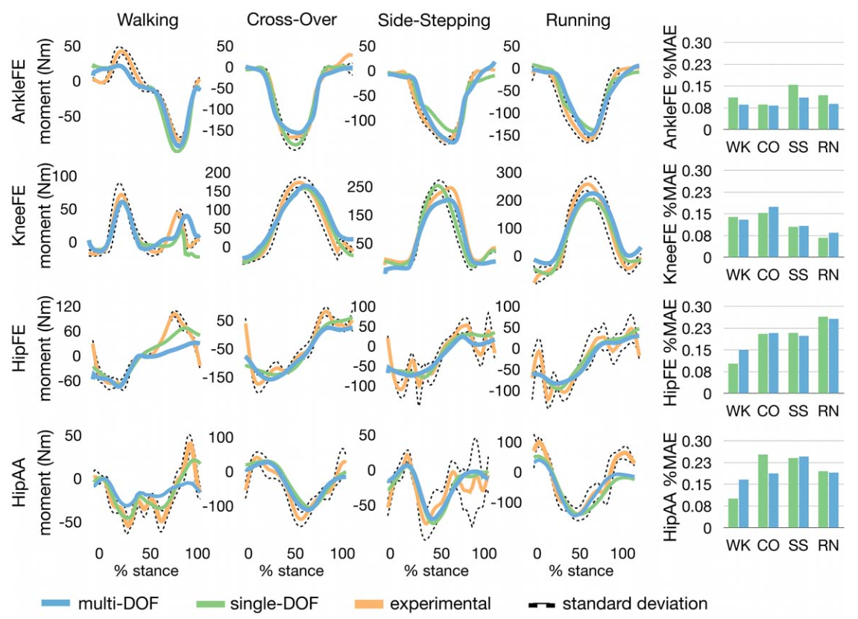
Multi DOF Model – Results
Running task: rectus femoris
Force (N)
hip roll (AA)
MTU
hip pitch (FE)
rectus
femoris
knee pitch (FE)
rectus femoris EMG data

Slide 11
General Difficulties and Sources of Error
marker placement & tracking
real vs. virtual markers
tracking accuracy
repeatability
inverse kinematics
drift of markers
joint modelling
numerical errors
inverse dynamics
measure of external forces
distribution of body mass
numerical errors
Motion Capture
Inverse Kinematics
Inverse Dynamics
Musculoskeletal Simulation
marker trajectories
joint angles
forces, torques
muscle activation and forces
generalizability (subject ⬄ model)
individual neural drive and activation strategies
MTU params highly dependent on subject
model scaling
marker points
distribution of body mass
…
(neuro)muscular redundancy
muscular := several muscles for one joint or muscles spanning multiple joints
neurophysiological := task-dependent activation strategies or multiple neurons innverating the same muscle
co-contraction
MTU modelling
tendon slack length,
optimal fiber length
and maximum isometric force
…
EMG ⬄ muscle activation⬄ muscle forces
mapping poorly understood,
no reliable models
Motion Simulation
Forward Kinematics
Forward Dynamics
Musculoskeletal Modelling
marker trajectories
joint angles
forces, torques
muscle activation and forces
EMG extraction and processing
surface EMG only (no deeper MTUs)
characterizing frequency bandwidths
➔ generalizability?

Slide 12

Thanks for your attention! From Motion Capture to Musculoskeletal Simulation and back
Questions?

Slide 13
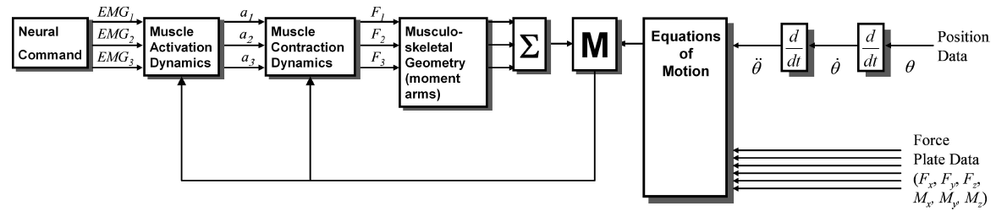
Appendix – Hybrid Approach
Motion Capture
Inverse Kinematics
Inverse Dynamics
Musculoskeletal Simulation
marker trajectories
joint angles
forces, torques
muscle activation and forces
validate
validate
validate
validate
Motion Simulation
Forward Kinematics
Forward Dynamics
Musculoskeletal Modelling
marker trajectories
joint angles
forces, torques
muscle activation and forces
Idea: Combine both forward and inverse simulation in order to obtain, validate and refine internal parameters and models at any point in time!
➔ successively estimate unknown model components and drive prediction errors to zero

